Slide 1
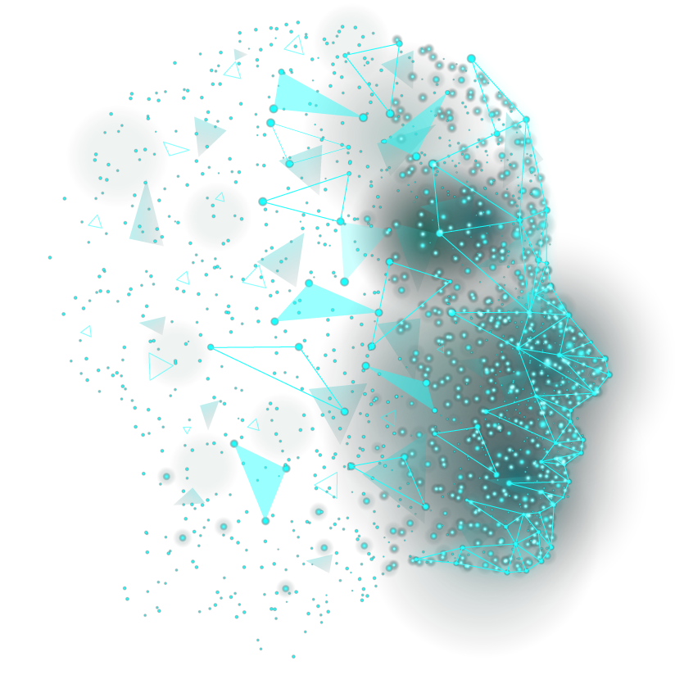
CAPSTONE PROJECT
AI QUIZ CRAFT
Harnessing BERT Extractive Summarization, WordNet, and ConceptNet for MCQ Generation
PRESENTED BY:
PRIYADHARSHINI H,
AU211521244041,
B.TECH. COMPUTER SCIENCE AND BUSINESS SYSTEM

Slide 2
TABLE OF CONTENTS
01
04
02
05
03
06
PROBLEM STATEMENT
ALGORITHM FLOW
PROPOSED SYSTEM
RESULTS
SYSTEM APPROACH
CONCLUSION

Slide 3

PROBLEM STATEMENT
Design an AI-based system capable of generating multiple-choice questions (MCQs) from any given content or news article. The system should employ advanced natural language processing techniques, including BERT Extractive Summarization, WordNet, and ConceptNet, to analyze the text, extract relevant information, and formulate questions that test the reader's understanding of the material. The generated MCQs should cover various aspects of the content, including key concepts, relationships between entities, and contextual understanding. The goal is to develop a robust and accurate system that can efficiently generate high-quality MCQs to aid in comprehension assessment and educational content creation across diverse domains.

Slide 4

PROPOSED SYSTEM
The proposed system combines BERT Extractive Summarization with WordNet and ConceptNet integration to achieve a comprehensive understanding of textual content.
By leveraging these algorithms together, the system can analyze text, extract key concepts, understand semantic relationships, and generate meaningful multiple-choice questions that assess comprehension effectively.

Slide 5
BERT Extractive Summarization
ALGORITHM OVERVIEW
WORKING PRINCIPLE
BENEFITS OF THIS ALGORITHM
BERT (Bidirectional Encoder Representations from Transformers) is a state-of-the-art NLP model developed by Google. BERT Extractive Summarization involves fine-tuning pre-trained BERT models to generate concise summaries of input text.
BERT models are trained on large corpora of text data to understand the contextual relationships between words. During summarization, the model identifies important sentences in the input text based on their relevance to the overall context.
BERT Extractive Summarization produces summaries that preserve the key information and main ideas of the original text. By leveraging contextual embeddings, it captures nuances and subtle meanings present in the text.

Slide 6
BERT Extractive Summarization
ALGORITHM OVERVIEW
WORKING PRINCIPLE
BENEFITS OF THIS ALGORITHM
BERT (Bidirectional Encoder Representations from Transformers) is a state-of-the-art NLP model developed by Google. BERT Extractive Summarization involves fine-tuning pre-trained BERT models to generate concise summaries of input text.
BERT models are trained on large corpora of text data to understand the contextual relationships between words. During summarization, the model identifies important sentences in the input text based on their relevance to the overall context.
BERT Extractive Summarization produces summaries that preserve the key information and main ideas of the original text. By leveraging contextual embeddings, it captures nuances and subtle meanings present in the text.

Slide 7
BERT Extractive Summarization
ALGORITHM OVERVIEW
WORKING PRINCIPLE
BENEFITS OF THIS ALGORITHM
BERT (Bidirectional Encoder Representations from Transformers) is a state-of-the-art NLP model developed by Google. BERT Extractive Summarization involves fine-tuning pre-trained BERT models to generate concise summaries of input text.
BERT models are trained on large corpora of text data to understand the contextual relationships between words. During summarization, the model identifies important sentences in the input text based on their relevance to the overall context.
BERT Extractive Summarization produces summaries that preserve the key information and main ideas of the original text. By leveraging contextual embeddings, it captures nuances and subtle meanings present in the text.

Slide 8
WordNet Integration
ALGORITHM OVERVIEW
WORKING PRINCIPLE
BENEFITS OF THIS ALGORITHM
WordNet is a lexical database that organizes words into synsets (sets of synonyms). It provides structured information about word meanings, relationships, and semantic similarity.
WordNet offers a hierarchy of word relationships, such as hypernyms, hyponyms & meronyms. By analyzing word relationships within WordNet, the system gains semantic understanding and can infer connections between concepts.
Integrating WordNet enhances the system's ability to comprehend the meaning of words and their contextual significance. It enables the generation of more accurate and contextually relevant multiple-choice questions.

Slide 9
WordNet Integration
ALGORITHM OVERVIEW
WORKING PRINCIPLE
BENEFITS OF THIS ALGORITHM
WordNet is a lexical database that organizes words into synsets (sets of synonyms). It provides structured information about word meanings, relationships, and semantic similarity.
WordNet offers a hierarchy of word relationships, such as hypernyms, hyponyms & meronyms. By analyzing word relationships within WordNet, the system gains semantic understanding and can infer connections between concepts.
Integrating WordNet enhances the system's ability to comprehend the meaning of words and their contextual significance. It enables the generation of more accurate and contextually relevant multiple-choice questions.

Slide 10
WordNet Integration
ALGORITHM OVERVIEW
WORKING PRINCIPLE
BENEFITS OF THIS ALGORITHM
WordNet is a lexical database that organizes words into synsets (sets of synonyms). It provides structured information about word meanings, relationships, and semantic similarity.
WordNet offers a hierarchy of word relationships, such as hypernyms, hyponyms & meronyms. By analyzing word relationships within WordNet, the system gains semantic understanding and can infer connections between concepts.
Integrating WordNet enhances the system's ability to comprehend the meaning of words and their contextual significance. It enables the generation of more accurate and contextually relevant multiple-choice questions.

Slide 11
ConceptNet Integration
ALGORITHM OVERVIEW
WORKING PRINCIPLE
BENEFITS OF THIS ALGORITHM
ConceptNet provides a rich source of background knowledge that can supplement the understanding of textual content. By querying ConceptNet, the system can access information about common sense relationships, factual knowledge, and conceptual associations.
Integrating ConceptNet enriches the system's semantic analysis capabilities by incorporating external knowledge beyond the input text.
It facilitates the generation of more contextually relevant and conceptually diverse multiple-choice questions.
ConceptNet is a large-scale knowledge graph that represents general human knowledge as a network of concepts and relationships.
It contains structured information about various concepts and their interconnections.

Slide 12
ConceptNet Integration
ALGORITHM OVERVIEW
WORKING PRINCIPLE
BENEFITS OF THIS ALGORITHM
ConceptNet provides a rich source of background knowledge that can supplement the understanding of textual content. By querying ConceptNet, the system can access information about common sense relationships, factual knowledge, and conceptual associations.
Integrating ConceptNet enriches the system's semantic analysis capabilities by incorporating external knowledge beyond the input text.
It facilitates the generation of more contextually relevant and conceptually diverse multiple-choice questions.
ConceptNet is a large-scale knowledge graph that represents general human knowledge as a network of concepts and relationships.
It contains structured information about various concepts and their interconnections.

Slide 13
ConceptNet Integration
ALGORITHM OVERVIEW
WORKING PRINCIPLE
BENEFITS OF THIS ALGORITHM
ConceptNet provides a rich source of background knowledge that can supplement the understanding of textual content. By querying ConceptNet, the system can access information about common sense relationships, factual knowledge, and conceptual associations.
Integrating ConceptNet enriches the system's semantic analysis capabilities by incorporating external knowledge beyond the input text.
It facilitates the generation of more contextually relevant and conceptually diverse multiple-choice questions.
ConceptNet is a large-scale knowledge graph that represents general human knowledge as a network of concepts and relationships.
It contains structured information about various concepts and their interconnections.

Slide 14
SYSTEM APPROACH
HARDWARE
Processor
Memory (RAM)
SOFTWARE
Python Environment
Additional Libraries
Storage

Slide 15
LIBRARIES
GENISM
A Python library for topic modeling, document similarity analysis, and other natural language processing tasks.
PKE
A Python library for key-phrase extraction.
SPACY
An open-source NLP library used for text processing, including tokenization, POS tagging, and dependency parsing.
BERT
A library for BERT-based extractive text summarization.
NLTK
The Natural Language Toolkit, providing various NLP functionalities such as tokenization, stemming, and word sense disambiguation.
PYWSD
A Python library for Word Sense Disambiguation (WSD), which can be useful for semantic analysis tasks.

Slide 16

ALGORITHM FLOW
TEXT ANALYSIS AND PROCESSING
INPUT TEXT
Users provide textual content or articles to the system.
PREPROCESSING
Text undergoes preprocessing steps, including tokenization, lowercasing, and punctuation removal.
Stop words are removed to filter out common, less informative words.

Slide 17
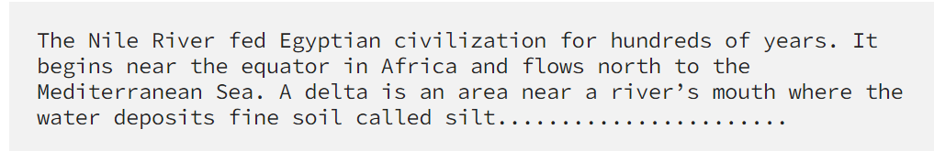
BERT EXTRACTIVE SUMMARIZATION
BERT models analyze the preprocessed text to identify the most relevant sentences.
Contextual embeddings are computed for each token, and sentence embeddings are generated based on these embeddings.
Sentences with the highest importance scores are selected to create a summary of the text.

Slide 18
SEMANTIC ANALYSIS WITH WORDNET AND CONCEPTNET
WordNet and ConceptNet are utilized to analyze semantic relationships and enrich the system's understanding of the text.
WordNet provides structured information about word meanings and relationships, such as synonyms, hypernyms, and hyponyms.
ConceptNet offers background knowledge and factual information relevant to the text.
MCQ GENERATION
Based on the summarized text and semantic analysis results, the system formulates multiple-choice questions (MCQs).
MCQs cover various aspects of the content, including key concepts, relationships between entities, and contextual understanding.
Plausible answer options are generated for each question to ensure that distractors are relevant and plausible.

Slide 19
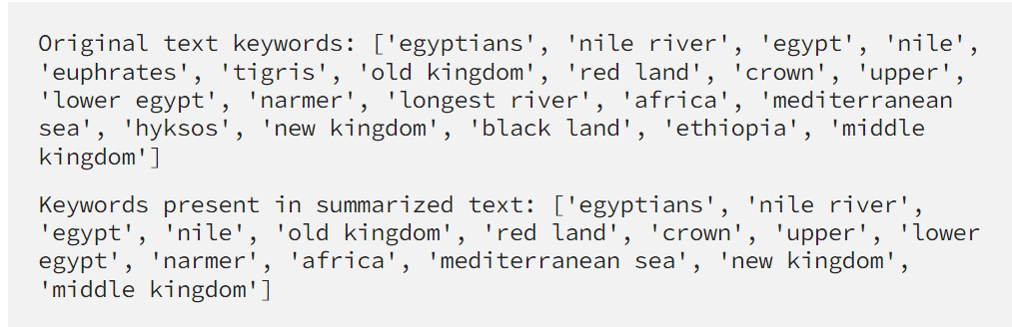
RESULT
BERT EXTRACTIVE SUMMARIZER
BERT EXTRACTIVE SUMMARIZER

Slide 20
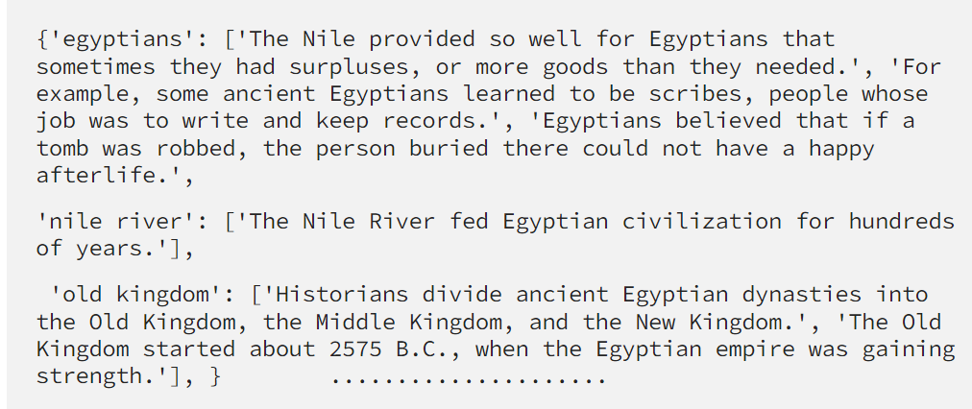
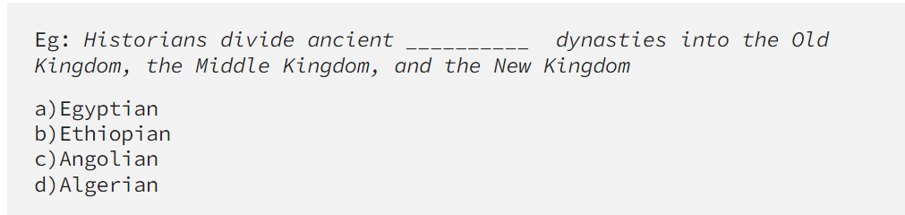
SENTENCE MAPING
GENERATED QUIZ

Slide 21

CONCLUSION
AiQuizCraft revolutionizes educational content creation by automating MCQ generation from text. Leveraging state-of-the-art NLP techniques like BERT Extractive Summarization and semantic analysis with WordNet and ConceptNet, it efficiently generates engaging quizzes and assessments. With its user-friendly deployment via GitHub and comprehensive documentation, AiQuizCraft empowers educators to enhance learning experiences, promote personalized learning, and improve educational outcomes. This innovative tool represents a significant advancement in educational technology, poised to transform comprehension assessment and educational content creation.

